Slide 1

The operation & importance of version control in the software life cycle
Dennis Riedy – Team Leader, Lead Developer
Paul McKenna – Lead Designer, Lead Documenter, Developer
Sean Fitzgerald – Lead Tester, Developer
Olzhas Aimukhambetov – Team Member

Slide 2
UberVision – Objective
Make a DVD rental administration system.
Two levels of access: Manager and Employee.
Manager has access to all area of the system with the extra features of adding/deleting stock, adding and editing customer customers and checking all DVDs that are rented as well as ones that are overdue.
Employee is allowed to search for a customer and carry out rental transactions as well as searching for a DVD.

Slide 3
Problems Encountered
Transitioning screens
Some disagreements
Researching new areas

Slide 4
Goals Set
Creating an easy to use system.
To allow user to be able to use the system with minimal amount of training.
To allow use for audio and visually impaired people.
Implement colour coding.

Slide 5
Goals Met
We achieved to create an easy to use system.
Allowed user to be efficient in system with minimal amount of training.
No allowances for audio or visually impaired people.
Some colour added although no colour coding.

Slide 6
achieving our goals
GUI worked on throughout the week and brought back to the group for testing/ analysis
With the suggestions went back to redevelop
Database was tested every week
Final weeks GUI and database merged and tested together

Slide 7
done differently?
Less time discussing extra features
More communication
Less confusion over the team roles and duties
More organisation over the workload

Slide 8
Design Process
What we considered?
Considered competition
Flexibility of use
Ease of use
Complexity of language

Slide 9
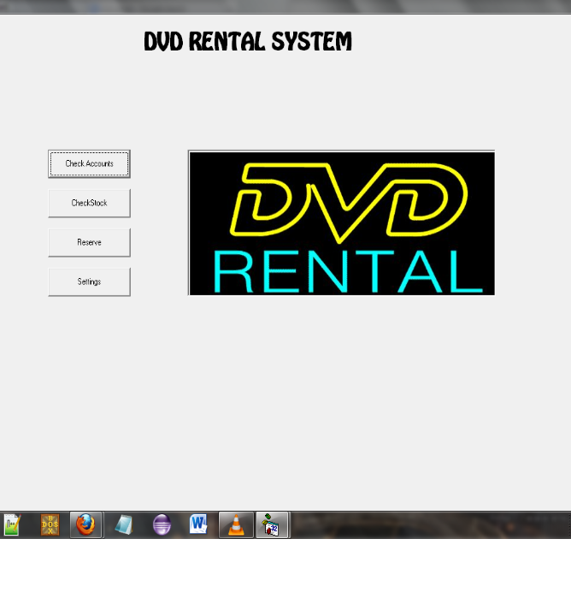
Our Planned Design
Planned menu screen
Four buttons
Simple design
Easy to use

Slide 10
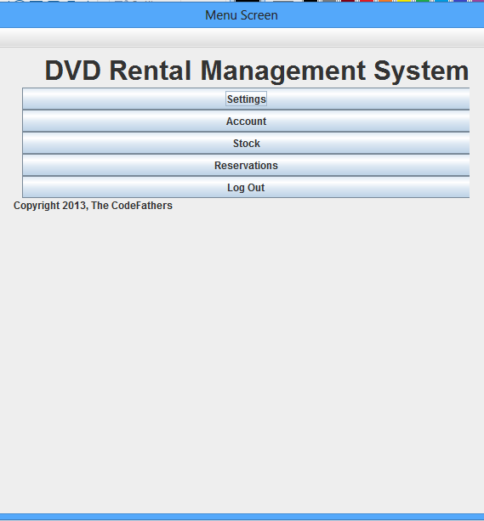
Our Design
Still simple design
Easy to use
Logout button added

Slide 11
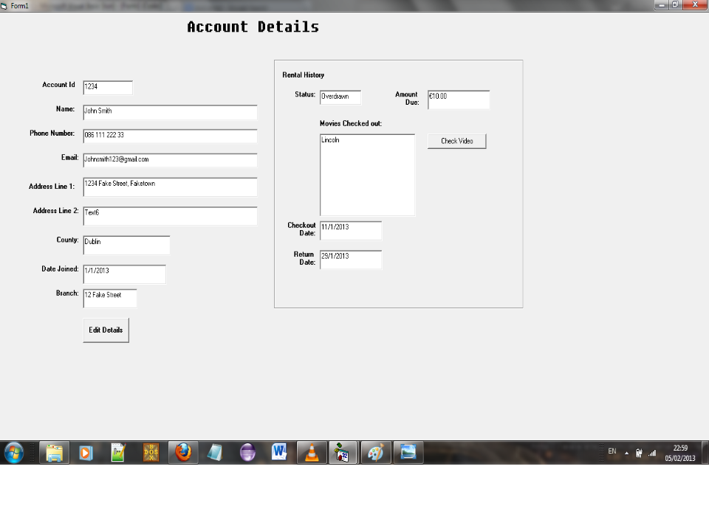
Our Planned Design
Clean design
Easy to understand
Requires little training
All information covered

Slide 12
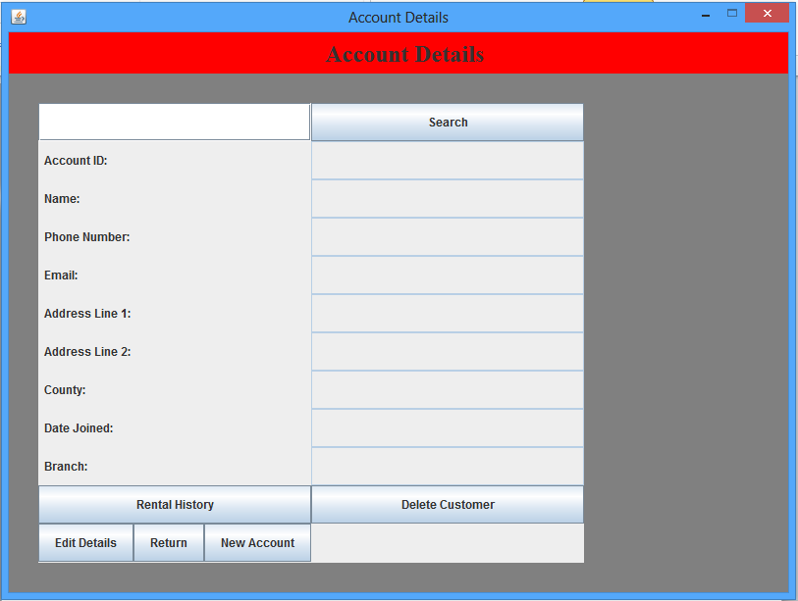
Our Design
Screen cut into two sections
Search by users name
Check rental history
New account
Edit and Delete

Slide 13
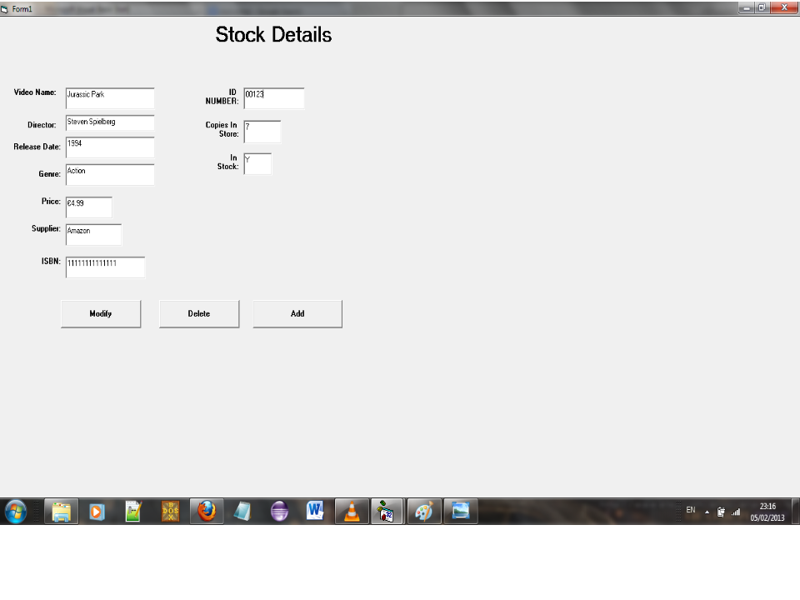
Our Planned Design
Again nice simple design
Only three options
Edit, Delete and add

Slide 14
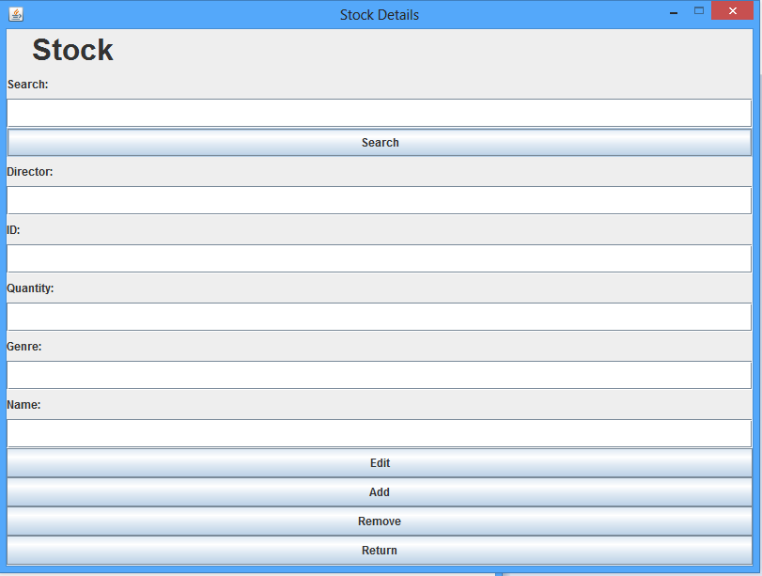
Our Design
Ability to search stock by title
Get only important information
Edit, Add, Delete and return

Slide 15
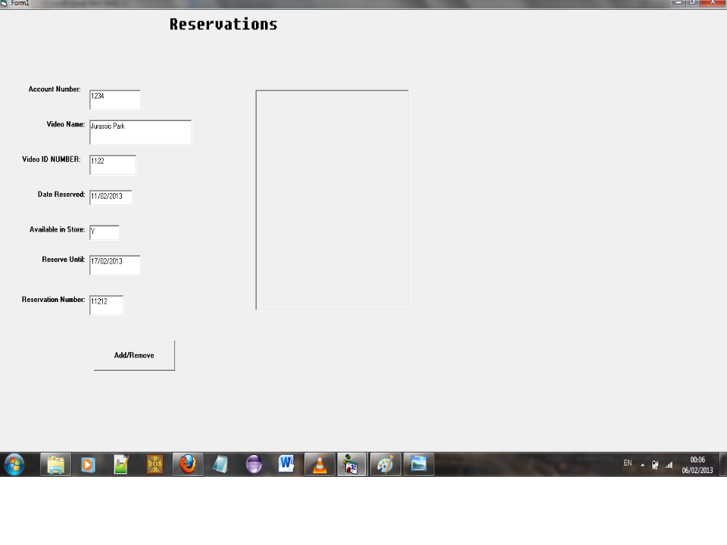
Our Planned Design
Requires extra information that needed
Either add or remove a reservation

Slide 16
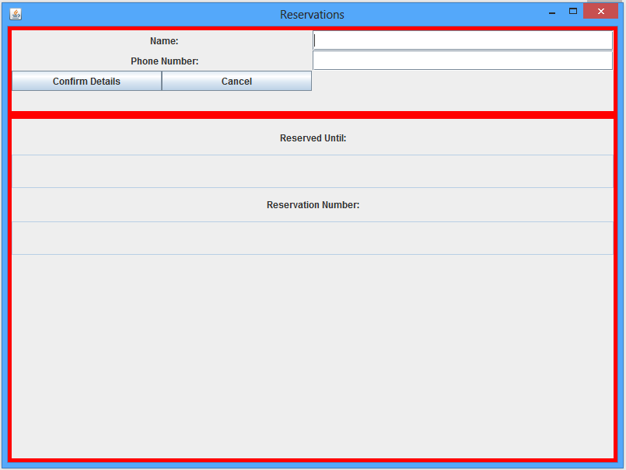
Our Design
Only important information required
Confirm and cancel button
Reservation number received
date till held

Slide 17
Why we made these changes
Extra information was needed
Too much information given
Easier to use
Clear pattern when using
Fit in extra features

Slide 18
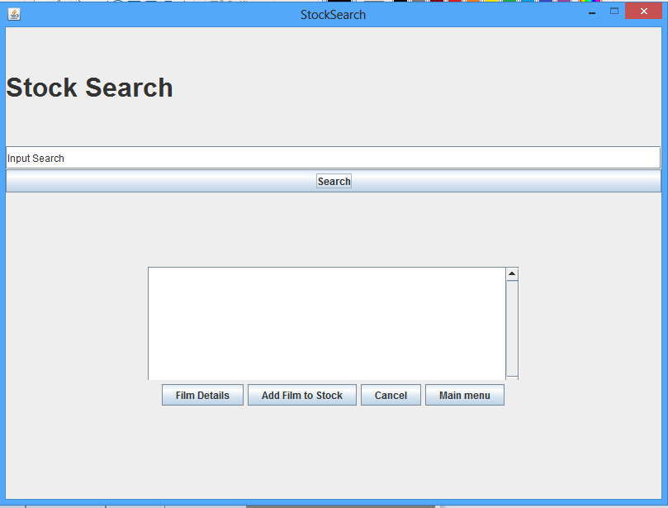
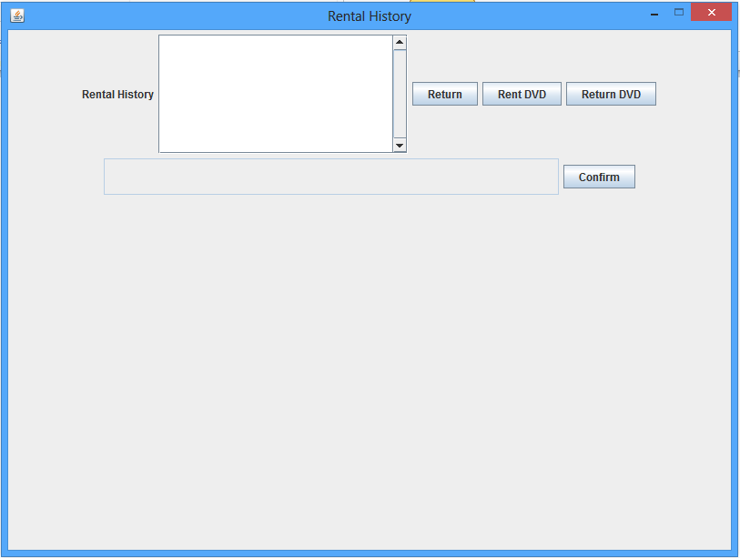
A few extra screens added
Searching Stock
Searching Rental History

Slide 19
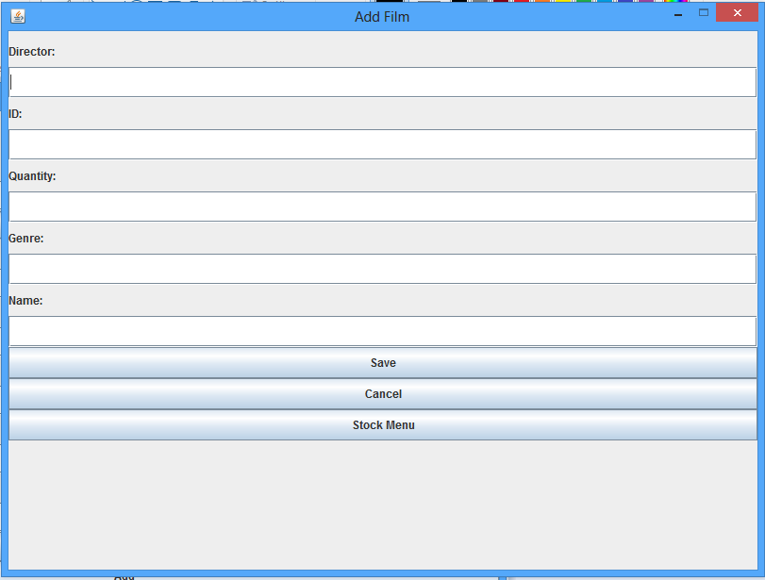
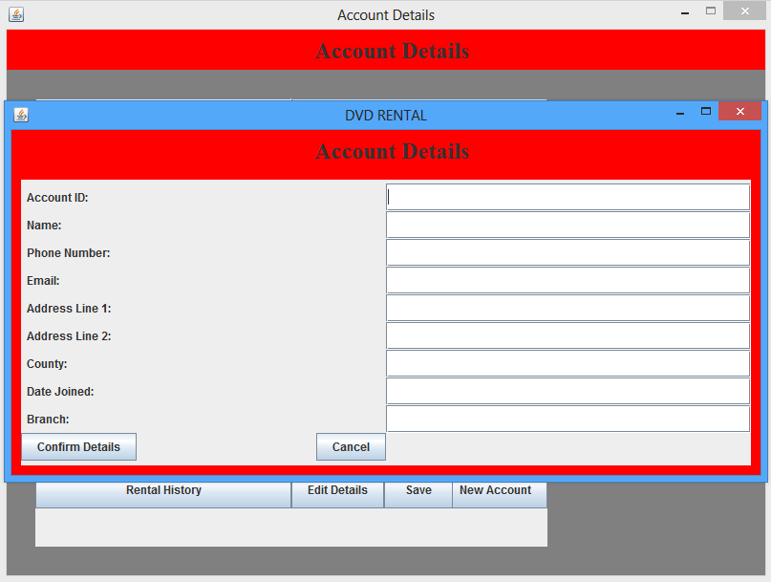
extra screens continued
Adding New Film
Adding New Account

Slide 20


